Slide 1

Sales and Profit Performance
KPI-based analysis of regional and product performance (2014–2018)
NAME:KAVYASHREE M
DATE :05/06/25
TOOLS USED:TABLEAU

Slide 2
OBJECTIVE
Analyze key business metrics (Sales, Profit, Discount)
01
Understand performance over time
02
Identify best/worst-performing regions and products
03
Support business decisions through data storytelling
04

Slide 3
DATA SOURCE
Dataset: Sample - Superstore .csv(Kaggle)
Records: ~10,000
Fields Used:
Sales, Profit, Discount
Region, State, Sub-Category
Date: Order Date, Ship Date

Slide 4

BUSINESS SUMMARY METRICS
Total Sales: 2.29M
Total Profit: 286K
Total Discount Transactions: 1,561

Slide 5
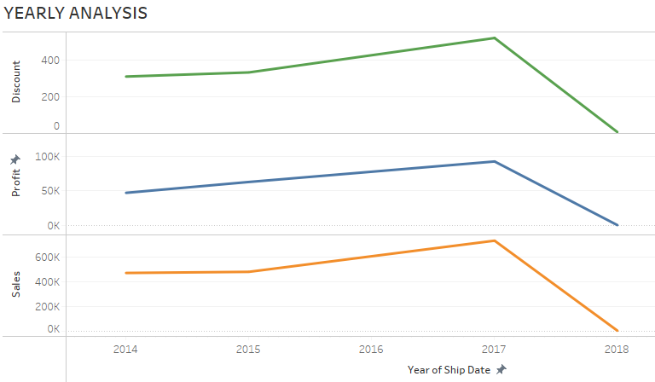
YEARLY ANALYSIS
Sales increased steadily till 2017, then slightly dropped in 2018.
Profit peaked in 2017.
Discounts spiked in 2017, which may relate to profit trends.

Slide 6
Sales by Region (Top States)
Top 3 States: California, New York, Texas
California leads with highest sales (~450K)
Potential to improve performance in lower-tier states like Virginia and Michigan

Slide 7
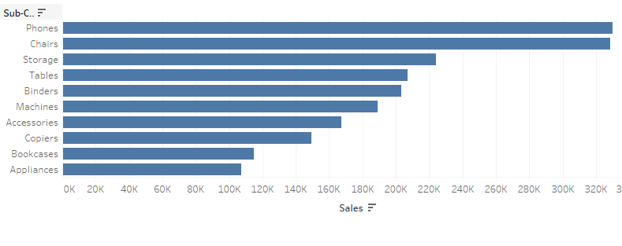
Top-Selling Product Sub-Categories
Phones, Chairs, and Storage are top-selling sub-categories.
Appliances and Bookcases underperform — opportunity for improvement or marketing focus.

Slide 8
Insights & Recommendations
California is the top sales driver — replicate strategies in other regions
Discount strategies need review — may be affecting profitability
Focus more on high-performing products like Phones & Chairs
Consider promotions or product adjustments in low-performing categories

Slide 9
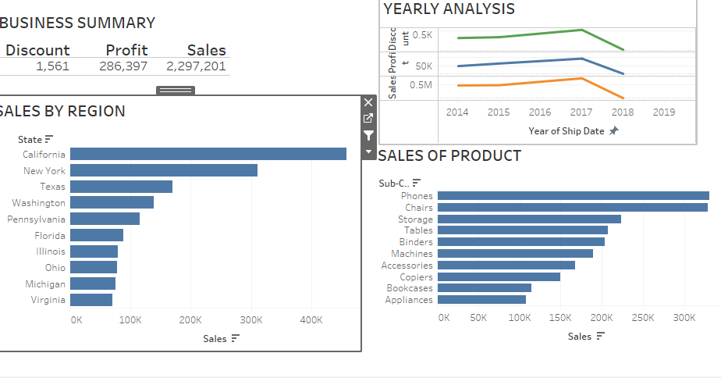
Conclusion
Tableau dashboard provides deep visibility into key business KPIs
Regional and product-level views enable data-driven decision-making
Strong foundation for predictive analysis and future forecasting

Slide 10

THANK YOU

